Slide 1
How to create a prompt by "NULL" and "NOT NULL" in an Alma Analytics report
Yoel Kortick
Senior Librarian

Slide 2
The question
Create a field for "Has Vendor Interface" and "Does not have Vendor Interface"
Create a prompt on field "Does or does not have Vendor Interface"
Test it out

Slide 3
The question

Slide 4
The question
I have an analytics report that includes information about the electronic collection. One of the columns is "vendor interface name".
I want to add a prompt which lets the person running the report get all electronic collections which do or do not have a vendor interface name.
I tried making the prompt using the "IS NOT NULL" option in the filter and get error messages.

Slide 5
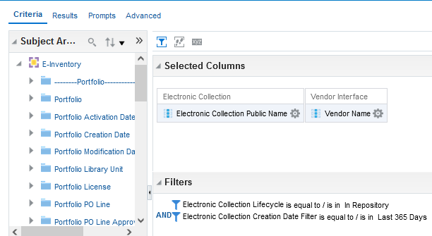
The question
Here is my criteria tab

Slide 6
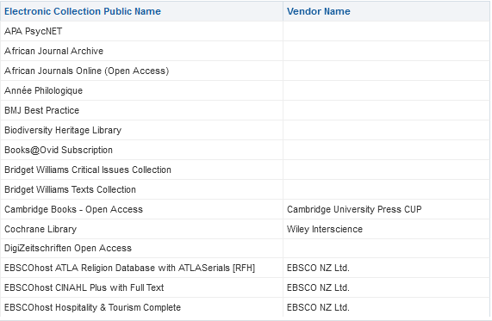
The question
Here are the results.
Some have a NULL vendor name

Slide 7
Create a field for "Has Vendor Interface" and "Does not have Vendor Interface"

Slide 8
Create a field for "Has Vendor Interface" and "Does not have Vendor Interface"
We will do as follows:
Create another field "vendor interface name"
On the new field we will use a CASE to make it be "Has Vendor Interface" or "Does not have Vendor Interface"
Later we will prompt on it but not display it

Slide 9
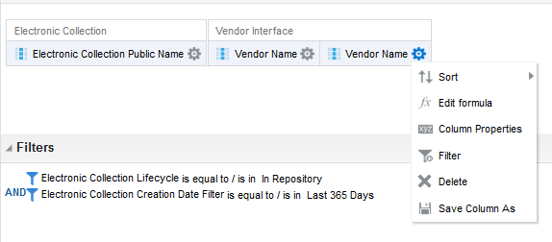
Create a field for "Has Vendor Interface" and "Does not have Vendor Interface"
Add another field "vendor interface name" and do "edit formula"

Slide 10
Create a field for "Has Vendor Interface" and "Does not have Vendor Interface"
Change
"Vendor Interface"."Vendor Name"
To
CASE "Vendor Interface"."Vendor Name"
WHEN NULL THEN 'Does not have Vendor Interface'
ELSE 'Has Vendor Interface' END

Slide 11
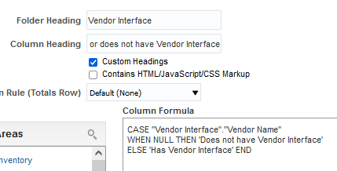
Create a field for "Has Vendor Interface" and "Does not have Vendor Interface"
Here it is
We called the column "Does or does not have Vendor Interface"

Slide 12
Create a field for "Has Vendor Interface" and "Does not have Vendor Interface"
The next slide includes the results.
It does state "Has Vendor Interface" and "Does not have Vendor Interface" correctly.
When there is a vendor it states "Does have Vendor Interface"
When there is not a vendor it states "Does not have Vendor Interface"

Slide 13
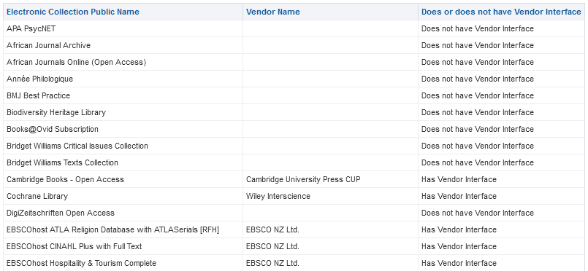
Create a field for "Has Vendor Interface" and "Does not have Vendor Interface"

Slide 14
Create a field for "Has Vendor Interface" and "Does not have Vendor Interface"
Note:
We called the new values "Has Vendor Interface" and "Does not have Vendor Interface"
Theoretically we could have called them “NULL” and “NOT NULL”
However, it is not a good idea to call the values NULL and NOT NULL as these are “taken” words and could cause problems later.

Slide 15
Create a prompt on field "Does or does not have Vendor Interface"

Slide 16
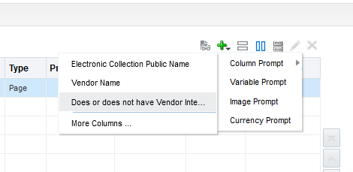
Create a prompt on field "Does or does not have Vendor Interface"
From the "Prompts" tab choose "new > column prompt > Does or does not have Vendor Interface"

Slide 17
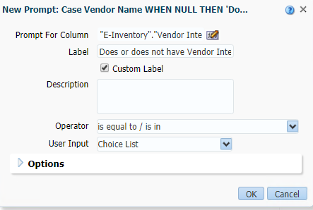
Create a prompt on field "Does or does not have Vendor Interface"
Define as desired. Here we leave the defaults

Slide 18
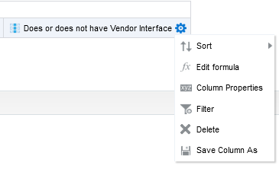
Create a prompt on field "Does or does not have Vendor Interface"
In the criteria tab remove the field "Does or does not have Vendor Interface" from display. It is enough to leave in the prompt.

Slide 19
Test it out

Slide 20
Test it out
Let’s open the report

Slide 21
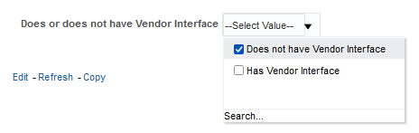
Test it out
Let’s choose "Does not have Vendor Interface"

Slide 22
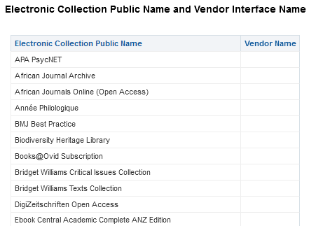
Test it out
For all results vendor interface name is NULL

Slide 23
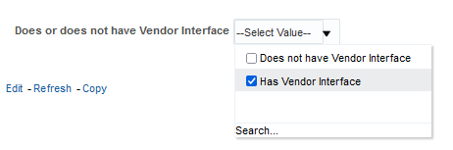
Test it out
Let’s choose "Has Vendor Interface"

Slide 24
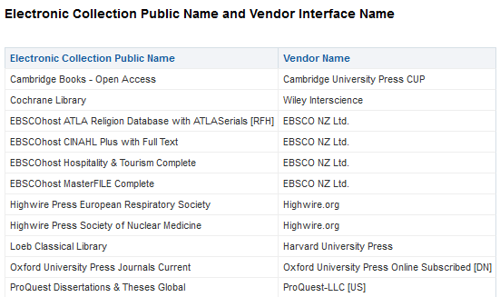
Test it out
For all results vendor interface name is NOT NULL

Slide 25
Thank you!
xxx@exlibrisgroup.com

